Slide 1
SEMANTIC SEGMENTATION FOR AUTONOMOUS DRIVING
NAME: VISHAL M DAVASAM

Slide 2
Overview
Abstract
Problem Statement
Introduction
Social/Environmental Impact
State of the Art work
Design
Deliverables
References

Slide 3
Abstract
This project aims to develop a real-time semantic segmentation model for autonomous driving using U-Net architecture.
The dataset used consists of 5 sets of 1000 images and labelled semantic segmentations captured using the CARLA self-driving car simulator.
U-Net architecture outperformed the other architectures in terms of accuracy and speed, allowing for the capture of both fine-grained and high-level features. After training, the U-net model was able to segment images and videos in real-time with 98% accuracy.
The development of accurate and reliable semantic segmentation models is crucial for improving road safety and advancing autonomous driving systems.

Slide 4
Problem Statement
Problem: Image segmentation is crucial in ADAS and autonomous vehicles, but existing models have limitations. U-Net is an efficient model for detailed segmentation in real-time. However, relying solely on semantic picture segmentation models can result in accidents due to occasional misclassifications. Autonomous vehicles use multiple sensors for obstacle detection. Video input causes temporal inconsistency, leading to segmentation variance. Current trends show that existing systems fail under extreme conditions, and even Level 2 ADAS with basic object detection and warning systems can malfunction.
Solution: Semantic Segmentation

Slide 5
Introduction
Semantic segmentation is the process of assigning each pixel of the input image into one of the predefined classes.
Also referred to as “pixel-wise classification”
Semantic segmentation allows autonomous cars to obtain an accurate representation of the outside world. It is used to define the available navigation space and the presence of obstacles necessary to calculate navigation trajectories.
The study compares three popular segmentation models, FCN, SegNet, and U-Net, and concludes that U-Net is the most effective due to its design features.
Also highlights the challenges of semantic segmentation, such as the relation between pixels in successive frames, and proposes a solution through algorithm comparison and efficient dataset creation.

Slide 6
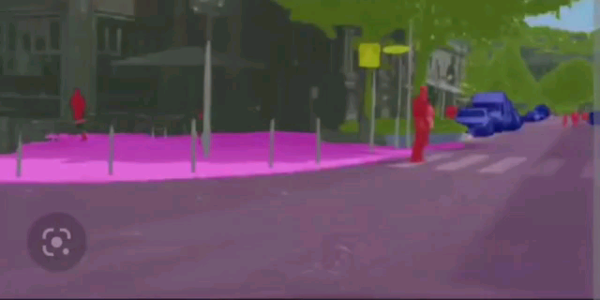
Semantic segmentation for Autonomous driving

Slide 7
Social/Environmental Impact/ Novelty
The goal of autonomous cars (AC) is to relieve the driver of this responsibility so that he can devote his time to other worthwhile activities.
.The use of this technology can make transportation more inclusive and accessible for people with mobility and vision impairments, older people, and those who find driving stressful.
It can also bring advanced features like lane changing and highway driving to Level 2 ADAS systems, making driving safer and more reliable.
The use of autonomous vehicles can significantly reduce traffic congestion, fuel consumption, and harmful emissions, leading to a safe.

Slide 8
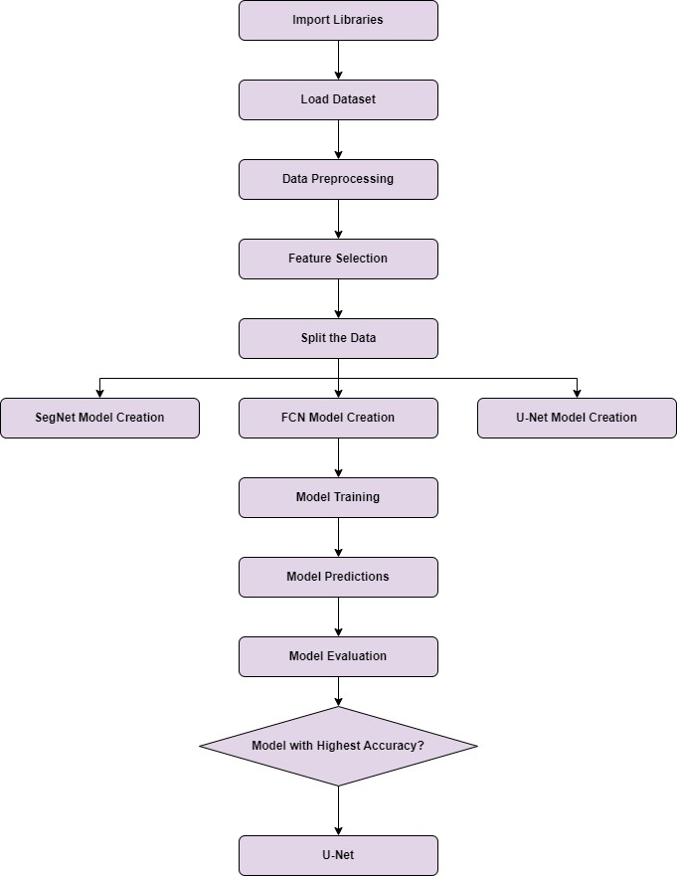
Design
Fig 1: Work flow of project

Slide 9
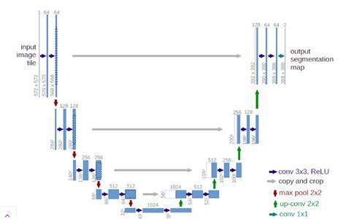
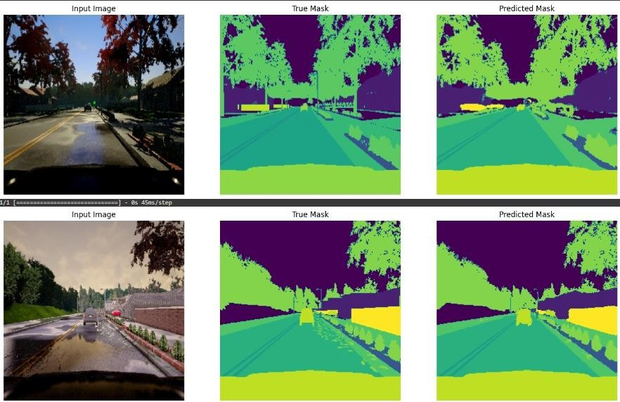
Design with Examples
Fig 3- Architecture of U-NET
Fig 3.1- Predictions with U-Net model

Slide 10
Implementation and Testing
https://colab.research.google.com/drive/1g_A8UOu4On25FVVvvEJ95wUPdtLSw4bN#scrollTo=W0wmfL7qfPrx

Slide 11
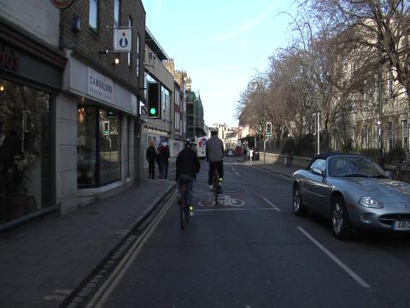
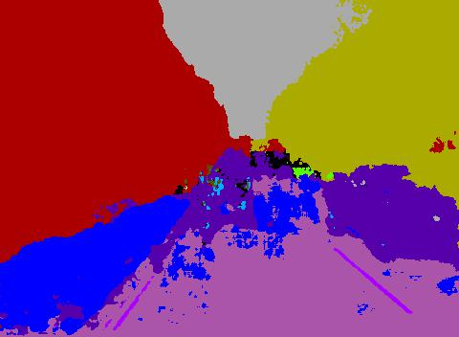
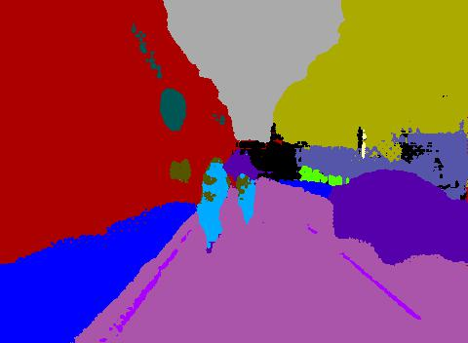
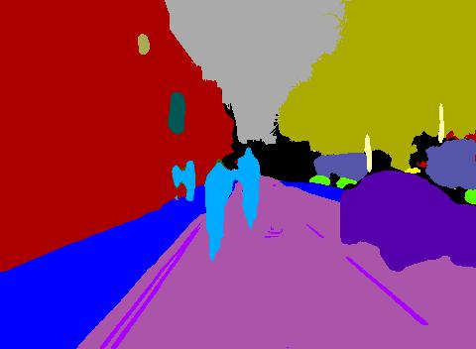
Results
Input Image
SegNet FCN U-Net

Slide 12
Results
Input Image predicted result using U-net

Slide 13
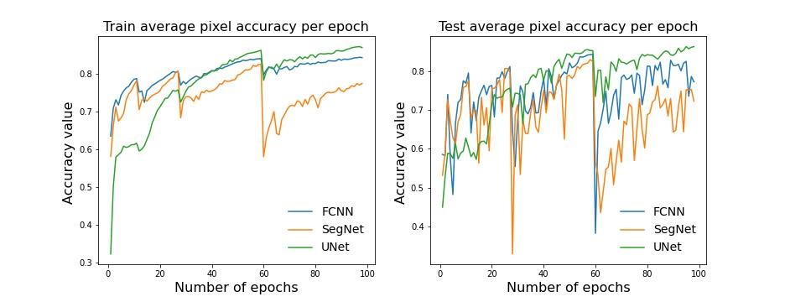
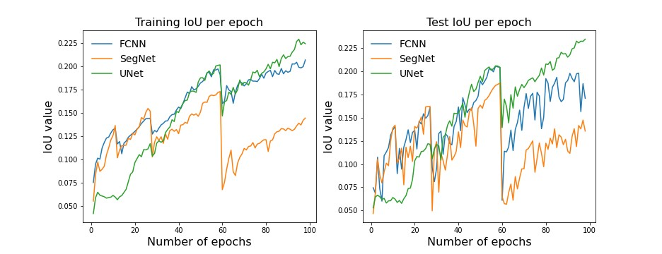
Results
Fig 5 -Train IoU Fig 5.1 -Test IoU
Train Accuracy Test Accuracy
Train IoU Test IoU

Slide 14
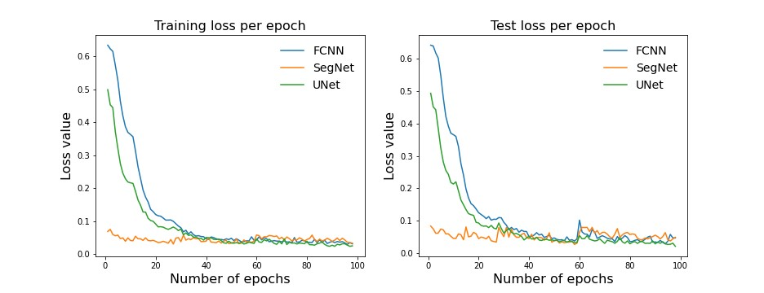
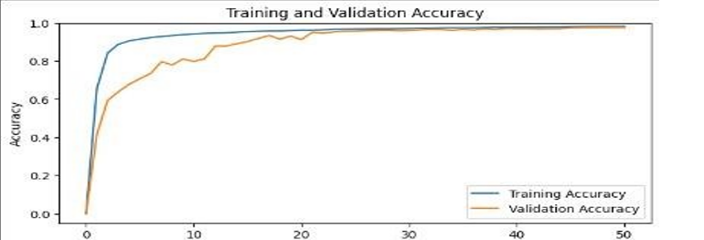
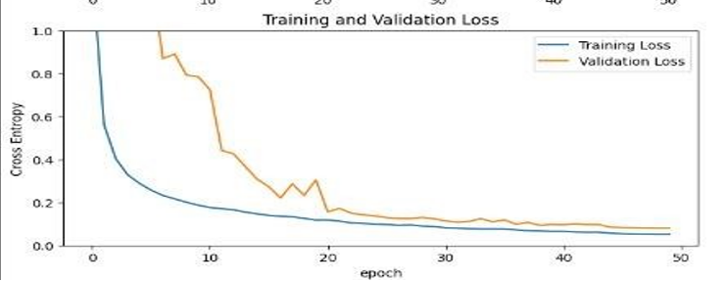
Results
Train Loss Test Loss
Training and Training and
Validation Accuracy Validation loss

Slide 15
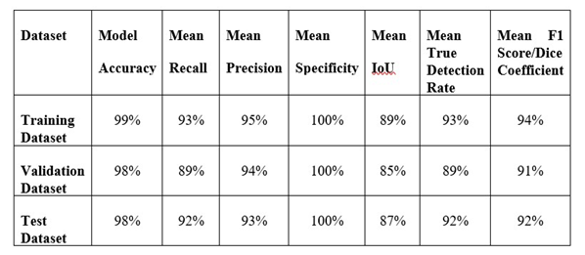
Discussion of Results
Overall result of project

Slide 16
State of the Art-work
Author’s Name/ Paper Title | Conference/Journal Name and year | Technology/ Design | Results shared by author | What you infer
Nisha M. Gohilot "Detection of Pedestrian, Lane and Traffic Signal for Vision Based Car Navigation" | 2021, 2nd International Conference for Emerging Technology (INCET) | Combination of computer vision and machine learning to build a system for vehicle, lane and pedestrian detection. | The distance of the vehicle from the monocamera is estimated and converted to vehicle coordinates. The ACF algorithm takes this as an attribute and modifies it to implement. | Using the ACF algorithm and the ground truth labeler tool, the detection and distance estimation is achieved.

Slide 17
State of the Art-work
Author’s Name/ Paper Title | Conference/Journal Name and year | Technology/ Design | Results shared by author | What you infer
Aditya Subramanian "Car Vision: Lane detection." | Chalmers University Of Technology, Gothenburg, Sweden 2017 | All calculations will be performed on the onboard Raspberry Pi 2 or a computer. The encryption-free communication interface between the car and the computer will make it possible to display and monitor the status of the autonomous car in real-time and simplify the signal processing from the computer to the car. | All focus was invested in the autonomous driving capabilities of the car. The system was able to find and detect lines from camera pictures and correctly plan the correct path the car should follow. | The system did a very good job of detecting edges, finding and correctly classifying the lines but it was not possible to implement a PID controller which could regulate the path of the car.

Slide 18
State of the Art-work
Author’s Name/ Paper Title | Conference/Journal Name and year | Technology/ Design | Results shared by author | What you infer
Senay Cakir "Semantic Segmentation for Autonomous Driving: Model Evaluation, Dataset Generation, Perspective Comparison, and Real-Time Capability" | Esslingen University of Applied Science, July 2022. | The road generator simulator and image processing. | Experimental results on the generated dataset confirmed that the segmentation model FasterSeg is fast enough to be used in real time on low power computational (embedded) devices in self-driving cars. | The experimental evaluation demonstrated that FasterSeg model reaches an accuracy of over 64 %

Slide 19
Conclusion
In conclusion, our project focused on developing a U-net model for semantic segmentation in autonomous driving, and we performed a comparative study was conducted on U-Net, Segnet, and FCN models using the Carla dataset. The U-net model was found to be the most efficient, achieving an accuracy of 98%. The model was evaluated on various metrics, and it was able to generalize well to new data.
The study concluded that accurate and reliable semantic segmentation models are crucial for the advancement of autonomous driving and driver assistance systems. With further research and development, more advanced and efficient systems can be expected to improve road safety and make driving a more comfortable and enjoyable experience for everyone.

Slide 20
References
Nisha M. Gohilot, Detection of Pedestrian, Lane and Traffic Signal for Vision Based Car Navigation, 2nd International Conference for Emerging Technology (INCET), 2021.
Aditya Subramanian, Car Vision: Lane detection and following. Department of Electrical Engineering, Chalmers University of Technology, Gothenburg, Sweden 2017.
Senay Cakir, Marcel Gauß, Kai Happeler, Yassine Ounajjar, Fabian Heinle and Reiner Marchthaler/ Semantic Segmentation for Autonomous Driving: Model Evaluation, Dataset Generation, Perspective Comparison, and Real-Time Capability, Esslingen University of Applied Science, July 2022.
Mostafa Gamal, Moemen Abdel-Razek, Mennatullah Siam, Senthil Yogamani and Martin Jagersand/ A Comparative Study of Real-time Semantic Segmentation for Autonomous Driving. 2018
Qusay Sellat, SukantKishoro Bisoy, Rojalina Priyadarshini, Ankit Vidyarthi, Sandeep Kautish and Rabindra K. Barik/ Intelligent Semantic Segmentation for Self-Driving Vehicles Using Deep Learning. Jan 2022
Towards Data Science (Blog)

Slide 21
THANK YOU!

